Slide 1


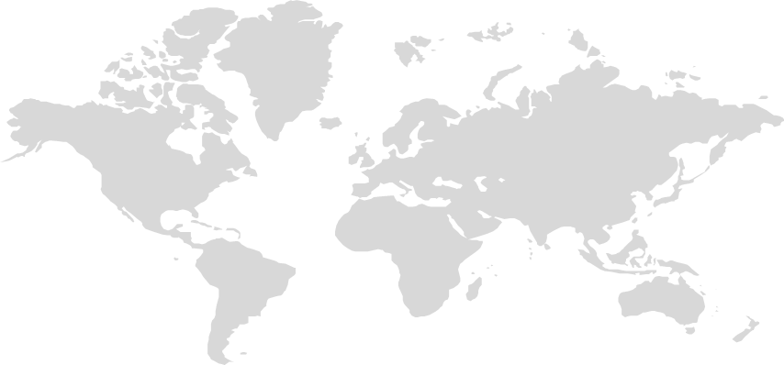
Solutions to Grow Your Business Globally,
Generate More Sales and Maximize Revenue

Slide 2




Introducing GlobalOne
GlobalOne is an easy to use payment platform that helps merchants
increase revenue, reduce costs and reach a global clientele.
Transactions
Beyond Borders
Technology Built to
Maximize Revenue
Proactively Manage
Your Payments
One point of integration allows you to sell globally. Multiple merchant accounts are supported through a single gateway. Simple!
GlobalOne's technology is built to increase your revenue. Our solutions also help reduce operating expenses to make your business highly efficient.
Don’t react to market forces, use them to your advantage. Our tools empower you to take action that boost your profits and increase your bottom line.
www.globalone.me

Slide 3
Providing Significant and Material Results
GlobalOne will significantly impact your top line and reduce your operating expenses.
One platform will materially change the way you perform global commerce!
Increase Your Revenue | Improve Your Bottom Line
Expand Your Global Reach Access High Growth Markets Increase Sales Conversions Reduce Card Declines Maximize Approval Rates | Consolidate Under One Provider Optimize International Transactions Lower Interchange Fees Reduce Risk and Liability Costs One Easy Integration
www.globalone.me

Slide 4

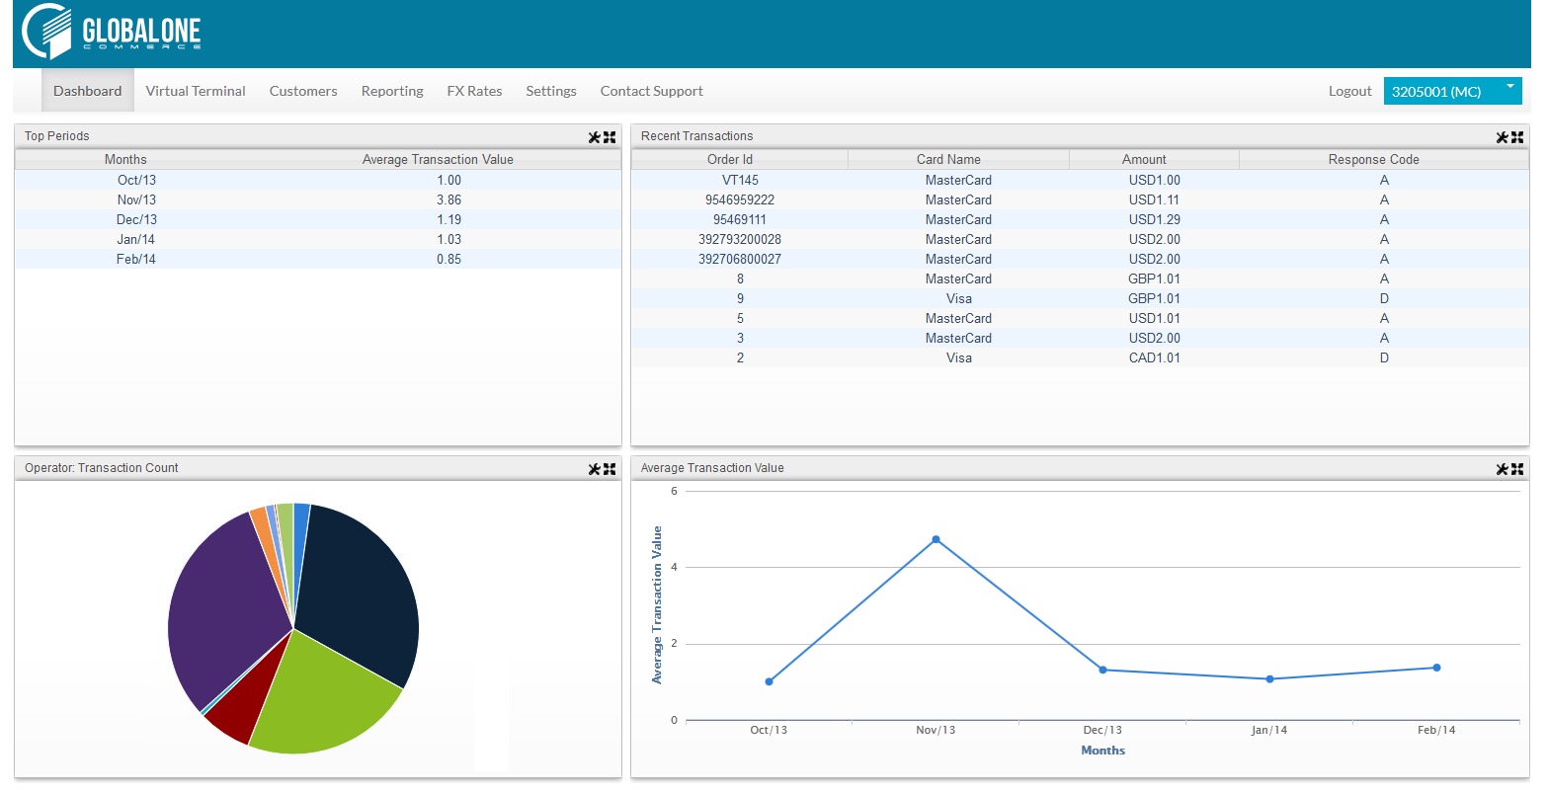
GlobalOne Dashboard
www.globalone.me

Slide 5

Transactions Beyond Borders
Worldwide e-commerce sales account for
over US$1.3 trillion dollars.
Are you profiting?
www.globalone.me

Slide 6


Transactions Beyond Borders
GlobalOne provides access to the world’s largest e-commerce regions and over 130 global payment processors.
EUROPE: $412.6BN
NORTH AMERICA: $389.5BN
ASIA PACIFIC: $301.6BN
35.1 %
33.1%
25.7 %
LATIN AMERICA, CARRIBEAN: $55.7BN
MIDDLE EAST, NORTH AFRICA
4.8 %
1.3 %
www.globalone.me

Slide 7



Transactions Beyond Borders
Multi-Currency Processing
Present and bill International shoppers in their currency and settle in yours. Plus, profit from local market pricing
Access to High Growth Markets
Get connected to millions of new clients in the highest growth regions and emerging markets
Alternative and Local Payment Methods
Accept payment types that are specific to the country or region where you do business to maximize sales
www.globalone.me

Slide 8


Multi-Currency Processing (MCP)
Price and sell in over 60 currencies to convert more sales, while settling in your local currency, with no special bank setup
Gain access to a global marketplace with no additional investment
Provide international clients a “local” shopping experience
Enhance client satisfaction and loyalty and reduce service needs by billing the exact amount cardholders will see on their statement
Easily test international markets prior to investing more heavily in foreign business infrastructure
MCP generates an average 12% increase in revenues due to the added convenience and improved shopping experience provided.
www.globalone.me

Slide 9



MCP: Profit From Local Market Pricing
Most products in countries outside of the US sell for a higher value, thereby allowing merchants to capture more revenue
US Web Store
UK Web Store
$519
£399
Benefit from the rate of exchange:
US$131 extra profit
(£399 = US$650)
www.globalone.me

Slide 10
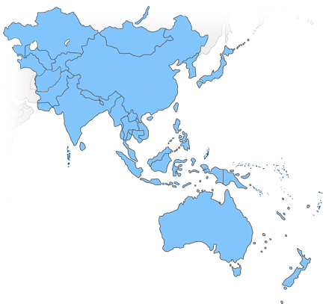
Access to High Growth Markets
Asia-Pacific accounts for nearly a third of all B2C e-commerce sales in the world, surpassing North America and Europe combined!
E-Commerce Growth 2014, 2015
25%
11.5%
11%
Asia Pacific
North America
Western Europe
Forecasted growth for Asia Pacific is on pace to outstrip that of North America and Western Europe by nearly 2 to 1.
www.globalone.me
Notes:
Asia Pacific forecasted growth rate of 29% in 2014, 21% in 2015 vs. 12%, 11% in North America, 12% 10% in Western Europe

Slide 11
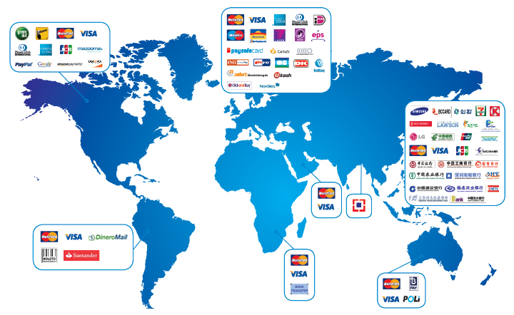
Supported Payment Methods
www.globalone.me

Slide 12

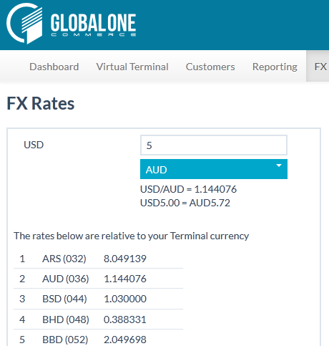
Supported Currencies
USD - US Dollar
EURO - Euro Unit
GBP - Pound Sterling
CAD - Canadian Dollar
ISK - Icelandic Krona
DKK - Danish Krone
“LIKE TO LIKE”
CURRENCIES
NOK - Norwegian Krone
CHF - Swiss Francs
HKD - Hong Kong Dollar
JPY - Japanese Yen
AUD - Australian Dollar
SEK - Swedish Krona
Bill cardholders and receive settlement in the same currency
More Than 60 Currencies Supported
www.globalone.me

Slide 13


Alternative and Local Payments
Merchants can accept payment types that are specific to the country or region where they do business
Accepting payment types that consumers prefer to use in their local markets greatly maximizes sales potential
More shoppers have a bank card than credit card; local payment types include debit and bank cards, opening a huge untapped market
It can also reduce risk involved with only accepting major credit cards
Alternative payments account for over $200 billion annually
The EU has less than a 50% credit card penetration rate. Germany, the EU’s largest market, has less than 35%!
Japan has a 60% credit card penetration rate, China 3%. Latin America, Africa and the Middle East even lower…
www.globalone.me

Slide 14





Technology Built to Maximize Revenue
GlobalOne's combination of hardware and software was built to increase revenues by providing more and better ways to make money, helping your business grow.
Auto Account Updater
Reduces declines from outdated card data, resulting in more sales completed
Omni-Channel Integration
We’ve simplified integrating payments across all sales channels
Decline Recycling
Resubmit previously declined transactions to recover potentially lost revenue
Auto Recurring Billing
Increase revenue and reduce time and cost associated with managing client accounts
www.globalone.me

Slide 15
Auto Account Updater
Automatically updates card changes prior to billing cycle to deliver a better payment experience to your clients
Conserve revenue streams by eliminating authorization declines
Reduce time and cost associated with manually updating card data
Uninterrupted payments improves client retention
Over 30% of credit cards change numbers or expire each year
www.globalone.me

Slide 16
Decline Recycling
Using proprietary algorithm, automates the resubmission of declined transactions to obtain the best chance of approval
Save the sale. Recover potentially lost revenue by resubmitting previously declined transactions
Analyzes card data and decline reason codes
Decline recycling is fully compliant with Visa and MasterCard regulations
www.globalone.me

Slide 17
Omni-Channel Integration
Engage with buyers no matter their location or what device they are on: E-Commerce, Mobile and brick & mortar under one unified platform
Improve sales by providing a consistent purchase experience across multiple sales channels and platforms
Higher client satisfaction leads to repeat purchases
Provide instant access to inventory, pick-up locations and more
www.globalone.me

Slide 18
Automated Recurring Billing
Automated recurring billing engine that provides recurring profitability solutions
Increases revenue and reduces time and cost associated with managing client accounts
Improved purchase experience and ongoing revenue streams
Secure card storage for repeat billing enhances profit and reduces risk
Subscription billing automation: Easy set-up of timed credit card transactions
Subscription database: Effective storage and management of subscription accounts
Multi-subscription support: Offer multiple, concurrent subscriptions with individual start/end dates, intervals and more
www.globalone.me

Slide 19




Improve Bottom Line Results
Reduce operating expenses and fees, optimize transactions, plus streamline your business operations.
Streamline Operations
Streamline operations by centralizing your global payments
Route Transactions Intelligently
Reduce cross-border fees and qualification rates, increase authorization approvals
Optimize Interchange
Optimize your transactions to the most cost-efficient acquirer, improve authorizations and minimize risk
Fraud Management and Security Modules
Reduce fraud losses with better management and Secure Card Storage
www.globalone.me

Slide 20

Streamline Operations
Centralize all global payment operations under a single provider and receive direct connectivity to international acquirers and banks through one gateway
Management: One login simplifies managing global merchant accounts
Integration: One point of integration reduces time and cost involved in accessing various platforms
Reporting: One portal provides advanced, consolidated reporting
Client Care: One provider, 2/47 support, to quickly resolve any issue
www.globalone.me

Slide 21
Optimize Interchange
Optimize international transactions, monitor and optimize your interchange costs and qualify for lower rates wherever possible
Lowers interchange costs to increase profit margins
Optimizes transactions to the most cost-efficient acquirer
Improve authorizations and minimize risk
The platform’s ability to integrate robust fraud measures can also lower processing rates
www.globalone.me

Slide 22
Route Transactions Intelligently
Optimizes payments through a set of rules applied in real time. Apply an unlimited number of customized rules and track their results
Lower processing costs and increase revenues by optimizing and improving authorization approval rates
Reduce time and effort by automating volume throttle between merchant accounts, ensuring it never exceeds the limit permitted by the processor
Reduce losses associated with potential cardholder fraud
Automatically throttle the volume limit for each merchant account
Better manage risk profile of each merchant account, e.g. route a higher risk product to a merchant account with a higher risk tolerance
www.globalone.me

Slide 23
Fraud Management
Robust and flexible integration to best of breed fraud modules, plus access to a global negative database of fraudulent credit cards, updated and filtered in real-time
Reduce losses associated with fraud
Operate within the guidelines of the Card Association rules
Access to Cardholder Dispute Resolution Network (CDRN)
Avoid chargebacks by issuing refunds to cardholders prior to a dispute
Resolve cardholder disputes with minimal effort to reduce operating expenses and improve customer support
www.globalone.me
Notes:
This slide needs re-working

Slide 24

Secure Card Storage
Secure Card Storage provides access to billing data without the liability of storing sensitive card information. Tokenization secures all payment-related functions
Reduce PCI liability scope while having the same access to billing data
Reduce resources required in managing security issues
Tokenization eliminates complex key management and can reduce data storage requirements
The token can be shared with other merchants on the GlobalOne platform for secure billing and access to a greater base of customers
What is Tokenization?
A method of replacing credit card information with a token, a random value that retains the card’s essential information without compromising security.
www.globalone.me
Notes:
This slide needs re-working

Slide 25



Expert Support and Resources
Implementing our solutions is fast and simple. Whether it’s to accept payments domestically or globally, we’ve got the team that will power your growth for years to come.
Rapid Implementation
Implement GlobalOne within hours and with minimal disruption to your business
VIP Client Care
Receive dedicated and knowledgeable support with lightning fast response times
Our Client Solutions Team is comprised of experienced payment professionals that understand YOUR business. Their goal is to help you implement and manage payment solutions while simplifying your life.
www.globalone.me

Slide 26
GlobalOne Client Solutions
Our business analysts help with fast, reliable implementation and technical specialists work with your team to monitor connectivity that ensures no disruption to your service
Analyzing and Adjusting to Your Evolving Business Needs:
Ensures that you have the optimal setup and deploy the services that would provide the most benefit
Easy implementation, with sample codes and a sandboxed environment
We work with you to create Smart Routing Rules
You can track results and adjust those rules if necessary
We recommend best practices and payment solutions that best benefit your business
We provide you with updates on the latest regulatory changes
www.globalone.me

Slide 27

Built for Developers
  Developers love us too. A simple API is all that's needed for painless and quick integration. A few lines of code...and you're done
<?xml version="1.0" encoding="UTF8"?>
<PAYMENT>
<ORDERID>115010922465</ORDERID>
<TERMINALID>6491002</TERMINALID>
<AMOUNT>10</AMOUNT>
<DATETIME>12-06-2012:11:47:04:656</DATETIME>
<CARDNUMBER>4111111111111111</CARDNUMBER>
<CARDTYPE>VISA</CARDTYPE>
<CARDEXPIRY>0817</CARDEXPIRY>
<CARDHOLDERNAME>John Blue</CARDHOLDERNAME>
<HASH>d04c3bab519095ecb046eff91722e8df</HASH>
<CURRENCY>EUR</CURRENCY>
<TERMINALTYPE>1</TERMINALTYPE>
<TRANSACTIONTYPE>7</TRANSACTIONTYPE>
<CVV>514</CVV>
</PAYMENT>
www.globalone.me

Slide 28



Custom Business Solutions
Whatever platform you’re on, wherever you need to accept payments,
GlobalOne delivers the solution right for your business
www.globalone.me
Notes:
Next steps need to be provided. For now, presenter speaks to them.

Slide 29
Business to Business
Level II and Level III support
  Capture and transmit important purchasing card information
  Includes line item details such as purchase order #, customer ID, tax data, etc.
Electronic Bill Presentment and Payment (EBPP)
  Upload electronic invoice to customer with detailed line item description
  Online payment options available: credit card or ACH
Business Integrations
  Two-way integration with leading accounting, CRM and ERP modules
  Allows software to push data directly to GlobalOne for billing
  Lower interchange fees by qualifying for Level II & III data
EBPP speeds up receivables and improves cash flow
Software integration streamlines payment processing and ledger input:
  Simplify reconciliation
  Reduce duplication of data entry
  Eliminate import/export processes
  Retain data integrity across systems
www.globalone.me
Notes:
Next steps need to be provided. For now, presenter speaks to them.

Slide 30

M-Commerce
  Optimized hosted payment pages for smartphones & tablets
  Responsive layout adjusts for various devices’ screen sizes, making it simpler for purchases to be made on mobile devices
  One click checkout speeds up the transaction process and integrates with popular wallets: Google, V.me, PayPal, etc.
  Shared token reduces need for separate profiles at checkout
Improve customer experience to increase sales and reduce shopping cart abandonment
Secure shared token reduces your PCI liability to reduce losses
Did You Know…
Retailers’ apps with a store mode gather 5X more engagement
46% of showrooming shoppers still ended up making a purchase in-store
There are more mobile devices on Earth than people!
www.globalone.me
Notes:
Next steps need to be provided. For now, presenter speaks to them.

Slide 31
www.globalone.me

